Slide 1
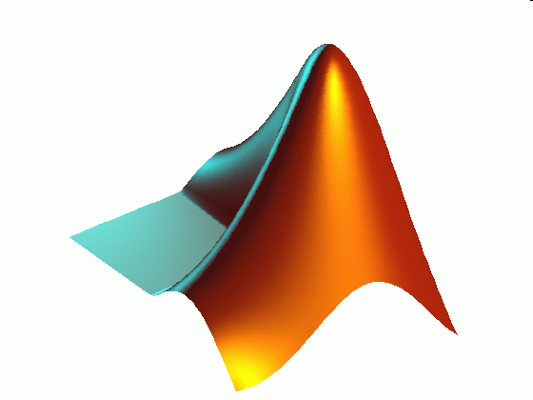
ME 203 Introduction to MATLAB
1

Slide 2
User Defined Functions
Matlab program that is created by the user, saved as a function file, and than can be used like a built in function
Generally has an input and an output
Input and output can be 1 or many variables (or no variables)
Variables can be a scalar, vector, or array
To use the functions, they must be in the current directory
Notes:
Scalar=number
Vector=1 dimensional array
Matrix=2 dimensional array
Array=row or column of numbers

Slide 3
Local Variables
Variables defined in an M-file function, only have meaning inside that program
If I set x=1 in the command window, it is NOT equal to 1 in the function
If I set y=2 in a function, it is NOT equal to 2 in the workspace window
The only way to communicate between functions and the workspace, is through the function input and output arguments
All variables inside a function are erased after the function finishes executing, except when the same variable names appear in the output variable list used in the function call

Slide 4
Global Variables
The global command declares certain variables global, and therefore their values are available to the basic workspace and to other functions that declare these variables global
The syntax to declare the variables a, x, and q is
global a x q
Any assignment to those variables, in any function or in the base workspace, is available to all the other functions declaring them global
BE CAREFUL!

Slide 5
User Defined Functions vs Scripts
Both saved as M files
Functions
Variables are local
Accepts data through inputs and returns through outputs
Function files should have the same name as the function
Scripts
Variables are recognized in the Command Window
Can use variables defined in the workspace
Notes:
Scalar=number
Vector=1 dimensional array
Matrix=2 dimensional rray
Array=row or column of numbers

Slide 6
Creating User Defined Functions
The first line in a function file must begin with a function definition line that has a list of inputs and outputs. This line distinguishes a function M-file from a script M-file. Its syntax is as follows:
function [output variables] = name(input variables)
-
-
end
For readability, use the end keyword to indicate the end of each function

Slide 7
Creating User Defined Functions
function [output variables] = name(input variables)
-
-
end
The output variables are enclosed in square brackets
If there is only one output variable, square brackets are not necessary
The input variables must be enclosed with parentheses
The function name (name) should be the same as the file name in which it is saved (with the .m extension).

Slide 8
Syntax
All functions have a similar syntax, whether they are built-in functions or user-defined functions
Name (cos)
Input (x)
Result (A)
A=cos(x)

Slide 9
User-defined functions must start with a function definition line
The line contains…
The word ‘function’
A variable that defines the function output
A function name
A variable used for the input argument
function output = poly(x)

Slide 10
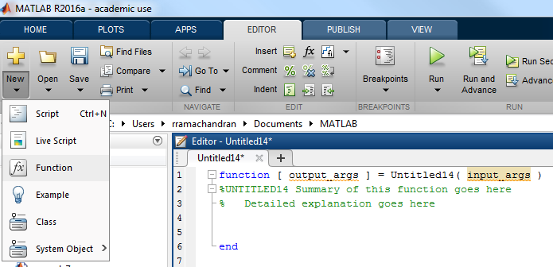
Create a function
Either choose a new script or a new function option

Slide 11
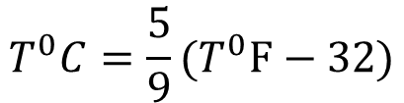
Example
Write a function that accepts temperature in degrees Fahrenheit and computes the corresponding value in degree Celsius.
$$T^{0}C=\frac{5}{9}(T^{0}F−32)$$
Input argument – temperature in ⁰F; variable name - fahrenheit
Output argument – temperature in ⁰C; variable name - celsius
function celsius = temp (fahrenheit)
%This function converts temperature
%from Celsius to Kelvin scale
celsius = (5/9)*(fahrenheit-32);
end
Notes:
function celsius = temp (fahrenheit)
%This function converts temperature
%from Celsius to Kelvin scale
celsius = (5/9)*(fahrenheit-32);
end

Slide 12
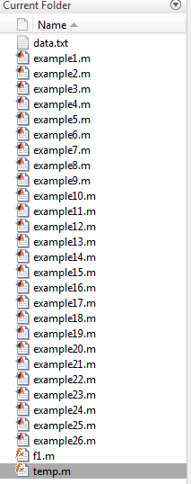
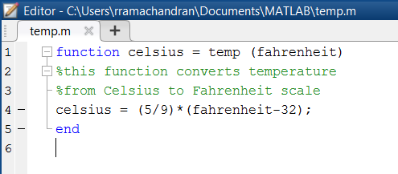
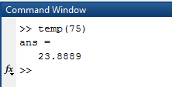
The function name must be the same as the file name
The function is available from the command window or from other M-file programs
The function file has to be in the current folder

Slide 13
Hint
While you are creating a function it may be useful to allow intermediate calculations to print to the command window. However, once you complete your “debugging” make sure that all your output is suppressed. If you don’t, you will see extraneous information in the command window.

Slide 14
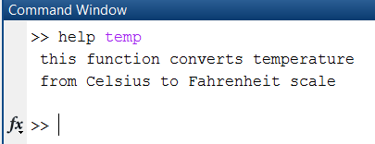
Comments
You should comment functions liberally, just as you would any computer code
The comment lines immediately after the first line are returned (shown) when you query the help function

Slide 15
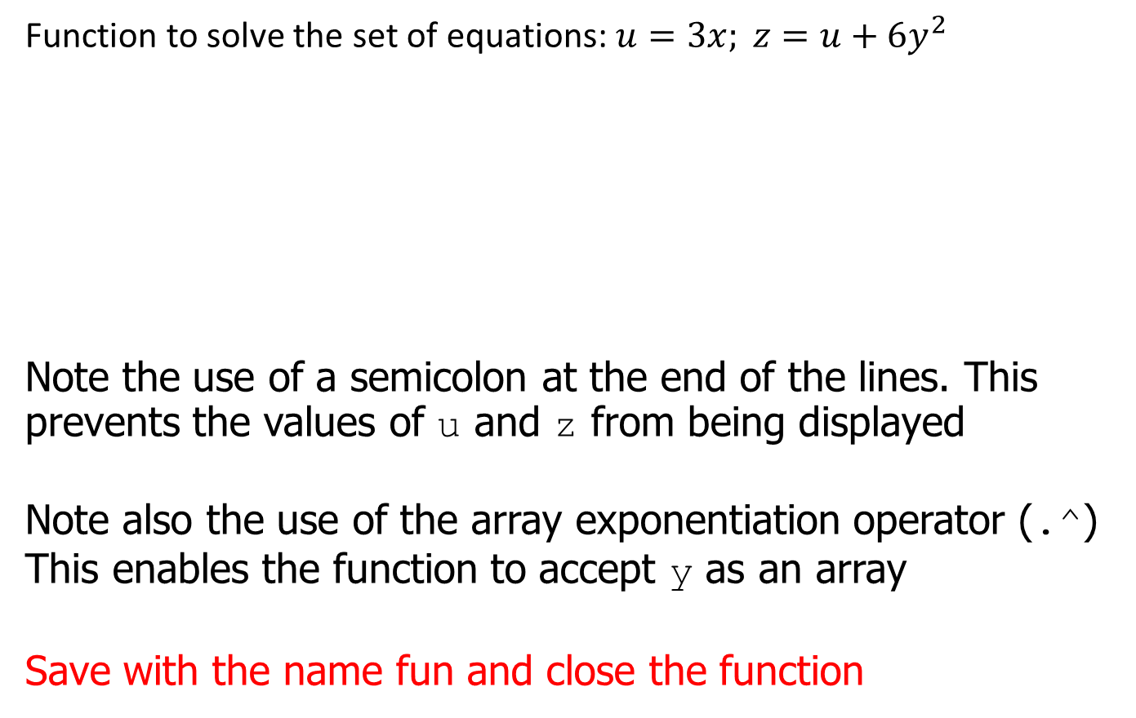
User-Defined Functions: Example
Function to solve the set of equations: $u=3x; z=u+6y^{2}$
Note the use of a semicolon at the end of the lines. This prevents the values of u and z from being displayed
Note also the use of the array exponentiation operator (.^) This enables the function to accept y as an array
Save with the name fun and close the function
function z = fun (x,y)
%Example - user defined functions
u = 3*x;
z = u +6*y.^2;
end

Slide 16
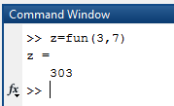
User-Defined Functions: Example (continued)
Call this function with its output argument in the Command Window:
>>z = fun(3,7)
z =
303
The function uses x = 3 and y = 7 to compute z.

Slide 17
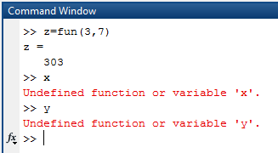
User-Defined Functions: Example (continued)
What if you call the variables x and y in the command window?
Variables x and y are local to the function fun

Slide 18
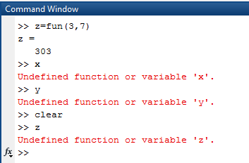
User-Defined Functions: Example (continued)
Clear your command window and call this function without its output argument and try to access its value
You will see an error message

Slide 19
User-Defined Functions: Example (continued)
Assign the output argument to another variable:
>>q = fun(3,7)
q =
303
You can suppress the output by putting a semicolon after the function call
For example, if you type q = fun(3,7); the value of q will be computed but not displayed (because of the semicolon)

Slide 20
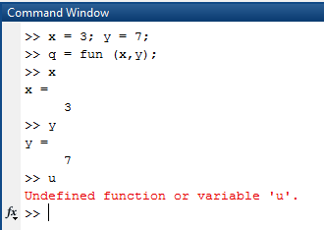
Local Variables
The variables x and y are local to the function fun, so unless you pass their values by naming them x and y, their values will not be available in the workspace outside the function. The variable u is also local to the function. For example,
fun(x,y) will return an error until x and y are defined!

Slide 21
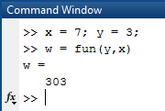
Function Notes
Only the order of the arguments is important, not the names of the arguments:
The second line is equivalent to w = fun(3,7)

Slide 22
You can use arrays as input arguments:
>>r = fun(2:4,7:9)
r =
300 393 498
Passes fun(2,7), fun(3,8), fun(4,9)

Slide 23
A function may have more than one output
A function may have more than one output
These are enclosed in square brackets
For example, the function circle computes the area A and circumference C of a circle, given its radius r as an input argument
function [A,C] = circle(r)
%Example - compute area and circumference
%of a circle of given radius
A = pi*r.^2;
C = 2*pi*r;
end

Slide 24
Calling a function with multiple outputs
The function is called as follows, if the radius is 4.
>>[x, y] = circle(4)
x =
50.2655
y =
25.1327
Notice that you have to “request” the outputs when there is more than one
Otherwise you only get the first output

Slide 25
Determining the number of input and output arguments
nargin(‘function name’)
Returns the number of input arguments
nargout(‘function name’)
Returns the number of output arguments
E.g.
>> nargin('circle')
ans =
1
>> nargout('circle')
ans =
2
Note: Function name is specified as a string

Slide 26

Function Notes
A function may have no input arguments and no output list
Example:
show_date clears the screen, computes and stores the date in the variable today, and then displays the value of today
function show_date
clc
today = date
end
Takes advantage of the built in function: date

